Slide 1
Effects of Storage Trends on Databases
May 27, 2016

Slide 2
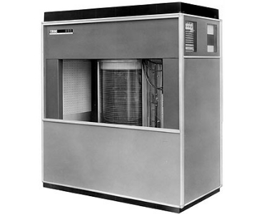
The Humble Disk Drive
IBM introduced the disk drive in 1956.

Slide 3
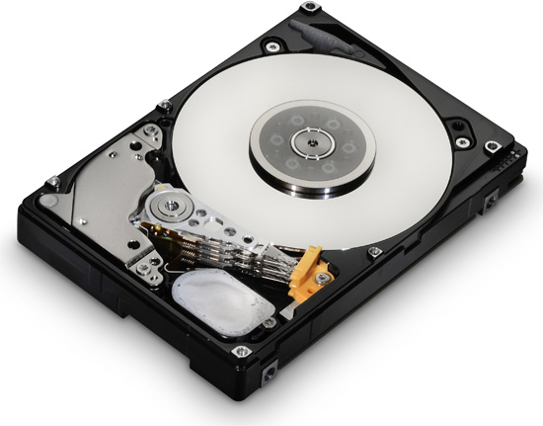
The Humble Disk Drive
A relatively simple landscape for 50+ years.

Slide 4
Media Landscape
1956-2006
DRAM
Capacity
$$$
FC
DISK
SCSI
SATA
TAPE
Performance
Access Latency

Slide 5
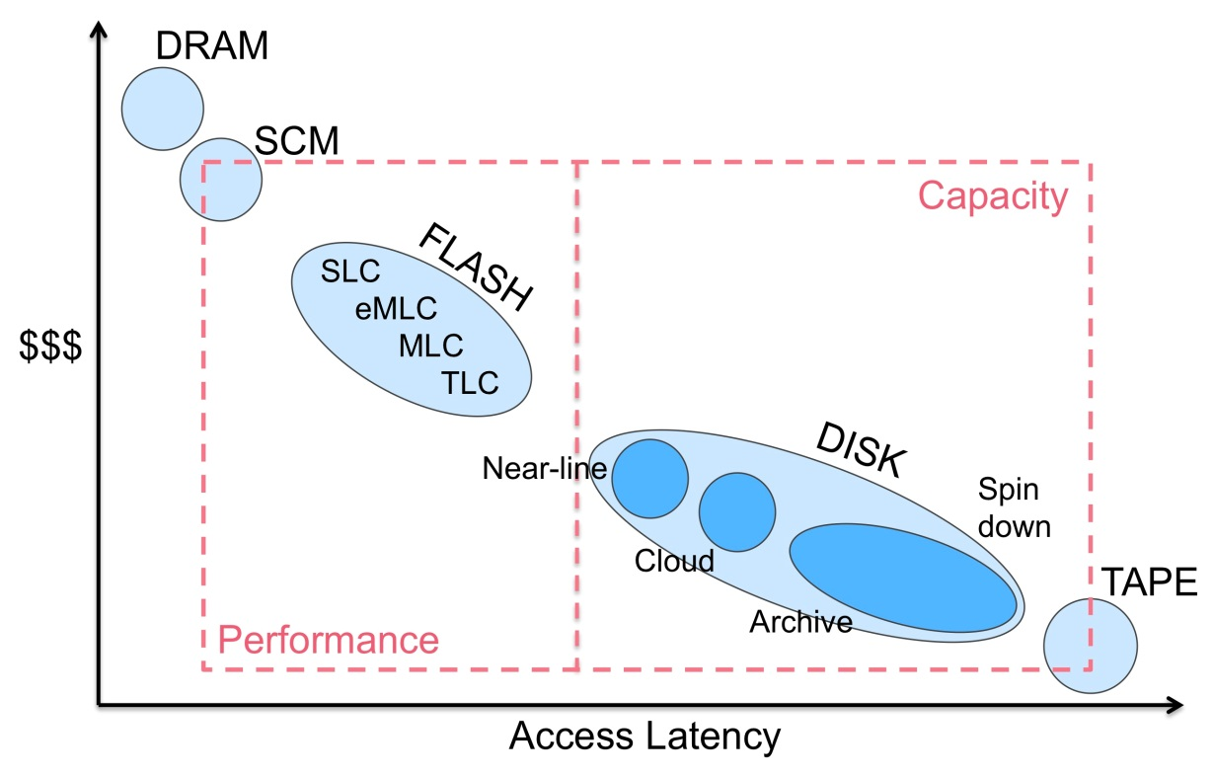
Media Landscape
Today
FLASH
Capacity

Slide 6
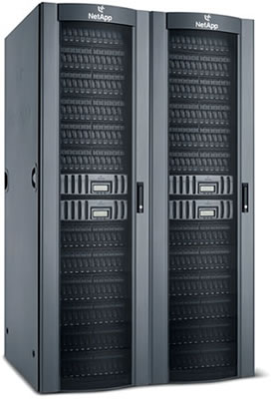
The Memory Hierarchy
Application
Oracle
SAP HANA
Updates (read/write/lseek)
Kernel (POSIX)
Buffer
Cache
VFS
NFS
blocks

Slide 7
The Memory Hierarchy
Application
We’re slaves to the
Persistence layer
Oracle
SAP HANA
Updates (read/write/lseek)
Kernel (POSIX)
Buffer
Cache
VFS
NFS
blocks

Slide 8
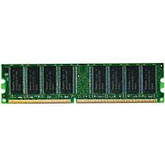
The Memory Hierarchy
Application
std::map (log₂N, log₂N)
std:list (constant, N)
boost::XXX
bytes
Control path (mmap, truncate)
Kernel (POSIX)
Buffer
Cache
VFS
NFS

Slide 9
(Naïve) History of Databases
Horizontal Decomposition (tables)
Record oriented
SEQUEL
(SQL)
Oracle
MonetDB
1956
1974
1979
1999
2006

Slide 10
Asymptotic Opportunity
End of the artificial dichotomy of OLAP/OLTP
Many “in-memory” databases have missed the opportunity
  Performance improvement restricted to inherent medium speedup (DRAM)
  New data structures with random access possible!
Tables (B+ tree derivative) or columns are artifacts of history
O(N) is not always the best way.
  Frequently leads to O(N²)

Slide 11
Doug Santry
dsantry@netapp.com

