Slide 1

Speaker notes
Purpose:
AI is uncharted territory for many non-IT business leaders, so IT leadership and the change management team must thoughtfully engage the right leaders and support them in their efforts. It’s important to lead with empathy and educate leaders about the opportunities and risks associated with AI transformation.
Use this guide to understand the importance of working with functional business leaders to drive AI transformation in your organization. Use this guide to also align expectations with these business leaders.
Outcomes:
Understand the crucial role of functional and business leaders in driving successful AI transformation.
Understand how to go about selecting and securing the right business leaders.
Achieve shared understanding of how these leaders will lean in to drive AI transformation with their teams.
Change management and CTO/IT leaders can leverage templates marked with the “Shared Activity” icon to achieve a shared understanding of the goals of Gen AI transformation, as well as align on the communications expected from Business Leaders to help drive user enablement.
Shared activity

Slide 2
Engaging leaders to drive business results with AI
A guide to engaging and activating business and functional leaders
Jan 2024

Slide 3

Microsoft 365 Copilot implementation
Human change
Prepare organization and employees for the AI transformation journey through user enablement programs
Copilot
readiness checklist
Workstreams support each other for maximum value and ROI
Microsoft 365 Copilot implementation
Sponsor
Scenarios
Security
Get ready > Onboard & engage > Deliver impact > Extend & optimize
Technical readiness
Address technical deployment and optimization, including governance, security, compliance, and management
You are here
Leadership journey

Slide 4

Everyone has a role to play in AI transformation
Delivering business results with Microsoft 365 Copilot requires organizations to harness it for business transformation and not simply as a tool for personal productivity. Functional and business leaders are pivotal partners for IT in positioning AI to solve for specific business problems and generate business value.
Executive Sponsor (CXO)
Functional Leaders
(e.g., VP of marketing, HR)
Business Leaders
(e.g., GM of Acme business)
Team Leaders
Individual Contributors
In partnership with CTO
User enablement
“The very first step of the journey is not even technical. It’s to establish a great partnership with the business. The number one goal is to deliver value to the company and to our customers.”
Andy Markus, AT&T Chief Data Officer

Slide 5
Transformation starts with your Executive Sponsor
  An effective Executive Sponsor is critical
  Executive Sponsors should:
Executive Sponsors may:
  Help identify and prioritize top business needs. Encourage shared planning between user enablement and technical implementation teams.
  Play a role in communicating the vision to leaders across the organization.
  Actively participate in and use the Microsoft 365 Copilot capabilities to help drive and reinforce enablement.
  Promote the enablement program. Studies show engaged employees are 2.6x² more likely to fully support a successful AI transformation.
  Lead or participate in the organizational AI Council.
  Have purchasing authority for licenses or services from supporting suppliers.
  Be directly accountable for Microsoft 365 or broader digital workplace initiatives.
#1
Active and visible executive sponsorship is the #1 contributor of change success over the last 25+ years of Prosci research¹
79%
Of organizations with extremely effective sponsors met or exceeded objectives compared to 27% with extremely ineffective sponsors¹
¹ © 2024 Prosci, Inc., Primary Sponsor's Role and Importance (prosci.com)
² Microsoft Viva People Science, The state of AI change readiness eBook

Slide 6
Business Leaders:
The linchpin for transformation

Slide 7
Business Leaders bring transformation to bear
Functional and business leaders are critical components of any major transformation. These leaders have the formal authority to legitimize change in their area of purview, and they actively oversee the work done by change advocates, agents, and employees.¹
For AI adoption, these leaders must be empowered to drive transformation and business value, as research shows the most successful business transformations are those that are driven from within the business; organizations that do so see higher success rates, more effective resource allocation, and higher employee engagement.²
Simply put, organizations that successfully transform with AI will be those that put these leaders in the driver’s seat on defining what to transform; bringing teams along; and activating managers and cross-functional partners like IT and HR to execute.
¹Connor Advisory, Characteristics of Effective Sponsorship
²© 2024 Prosci, Inc., Win-With-AI-Lead-the-Human-Side-of-Change.pdf (prosci.com)

Slide 8
Three key steps to identifying and securing Business Leaders
Selecting the right leaders to drive your desired transformation can be the difference between success and failure. Follow these three steps to identify and align with these leaders.
Identify the right leaders at the right level
Solicit
AI Council input
Align on expectations and available support
Prioritize leaders based on the business areas you are most focused on transforming.
Do not aim too high; research indicates the Vice President/General Manager level is optimal.¹
Consult your AI council to ensure leaders are a good fit and reflect overall business priorities.
Create materials and guidelines for leadership enablement.
Cement the 'why' and establish shared goals and outcomes.
Clarify how IT and other business partners (e.g., HR) can help the leader to successfully drive transformation.
¹© 2024 Prosci, Inc., Primary Sponsor's Role and Importance (prosci.com)

Slide 9

Microsoft
HR’s journey
Customer Story
As Microsoft’s flag-bearers for responsible AI and workforce transformation, Microsoft HR has been eager to transform itself with Microsoft 365 Copilot, and in doing so, prepare to aid in transforming the rest of the company.
Microsoft’s IT and HR partnership in transforming the HR organization
Liz Friedman, Senior Director and leader of several teams, was tapped to take the lead in working with MS Digital (Microsoft IT) to build an adoption strategy for HR.
Liz Friedman, Senior Director, HR AI Transformation
”We’re very intentional about defining our objectives, anticipating their benefits, and establishing OKRs to track those pieces. From there, we can verifiably demonstrate progress.”
The adoption strategy included high-value use cases, and an in-depth skilling plan led by MS Digital.
Liz’s ownership allowed HR to drive change that was authentic to the HR organization. Liz and team also leveraged Microsoft Viva to communicate and up-skill team members, and to measure impact.
How Microsoft HR is using Viva and Copilot for Microsoft 365 to empower our employees - Inside Track Blog

Slide 10
Identify your Business Leaders
Shared activity
Business unit / Function | Business Leader, role | Key representatives
IT | VP, AI Strategy
FINANCE | VP, FP&A
SALES | Head of Sales Operations Transformation
MARKETING | AVP, Marketing Strategy and Operations
OPERATIONS | VP, Business Operations
HR | General Manager, HR Transformation
LEGAL | Associate General Counsel

Slide 11
Leading in the era of AI
Setting expectations and driving shared accountabilities

Slide 12
Five steps to set Business Leaders up for success
Follow these steps to help Business Leaders prepare and lead transformation through to value realization
Align to the organization’s AI strategy
Articulate business goals and use cases
Set Microsoft 365 Copilot usage goals
Drive awareness of skilling plan and resources
Lead from the front
Anchor Business Leaders in the overall AI strategy. Help them understand why their function is a top priority for the company.
Ensure Business Leaders have a strong baseline understanding of Copilot’s possibilities and limitations so they can define the right vision for their own functions.
Help Business Leaders to set their own Copilot usage goals relative to benchmarks and empower them with data along the way.
Create awareness around skilling opportunities for leaders and their teams.
Support Business Leaders in an action plan that allows them to role model Microsoft 365 Copilot usage. Champion a transformation mindset, including things like curiosity, inclusiveness, and empathy.
Shared activity
Shared activity
Shared activity

Slide 13
Build early awareness of the ’experience gap’
Individuals experience change differently depending on where they are in the organization. Research shows these areas are top considerations for Business Leaders to drive transformation at all levels.¹
Communication
Skilling
Engagement
85% of Leaders believe their organization communicates consistently during change, only 55% of ICs agree.
86% of Leaders have good opportunities to improve skills, learn and grow during change, only 64% of ICs have this experience.
83% of Leaders feel included in decisions about change that affects their job, only 44% of ICs agree.
What this means:
If leaders don’t feel that they are over-communicating, they are probably not communicating enough. Leaders should consider campaigns, omnichannel approaches, and how to leverage team leaders to reinforce messaging, especially the why of the AI transformation.
What this means:
Ongoing learning will be a must. Democratize access to upskilling and Subject Matter Expert expertise through expert communities. These can be built by the AI champions who have energy and excitement for the use of Gen AI at work.
What this means:
Leaders should consider how they are capturing employees' sentiment and sense of involvement before, during, and after change and how they are implementing this feedback.
¹Microsoft, The State of AI Change Readiness

Slide 14
Articulate business goals and use cases
Shared activity
Department / Function | Top 3 use cases | Business outcomes / KPIs
The interactive Microsoft 365 Copilot Scenario Library gives business leaders inspiration on high-value scenarios to select, as well as KPIs they should measure for success.
Further prescriptive guidance on how to identify and prioritize scenarios with your business leaders, is available in the User Enablement Guide of the Copilot Success Kit.

Slide 15
Set Microsoft 365 Copilot usage goals
Shared activity
Department / Function | Microsoft 365 Copilot usage goal | Reporting frequency
Leverage the Microsoft Copilot Dashboard to measure and keep track of your organization’s enablement of Microsoft 365 Copilot on the Impact tab.

Slide 16
Lead from the front – [Function]
Shared activity
T-1 week: Activity
Gen AI Rollout to <function name>
T+1 week: Activity
T+2 week: Activity
Quarterly: Activity
Monthly: Activity
T+1 month: Activity
Date | Channel | Details
T-1 week
T+1 week
T+2 weeks
T+1 month
Monthly
Quarterly

Slide 17
Lead from the front – HR Transformation
Example: Communication plan for
HR Transformation team.
T-1 week: Email announcement
Gen AI rollout to HR
T+1 week: Email
T+2 week: Create alignment to overall purpose
Quarterly: Celebrate and recognize Champions
Monthly: Celebrate and reiterate skilling opportunities
T+1 month: Model daily habits
Date | Channel | Details
T-1 week | Email | Announce: Copilot is coming to our team! (Details of the why, learning resources)
T+1 week | Email | Encourage use: Email communications (Details of how to access + starter prompts + upcoming trainings)
T+2 weeks | Social | Alignment: Share the key use cases that the business leader is hoping to resolve. Encourage curiosity and problem-solving to come together to drive for business value through Gen AI.
T+1 month | Email | Model: Highlight leader’s favorite daily prompts in the monthly community newsletter
Monthly | Town hall Newsletter | Celebrate: Highlight team best practices during monthly events and in community newsletters. Skilling: Reiterate availability of learning resources
Quarterly | Town hall Newsletter | Celebrate: Recognize Champions in the organization. Skilling: Reiterate availability of learning resources

Slide 18
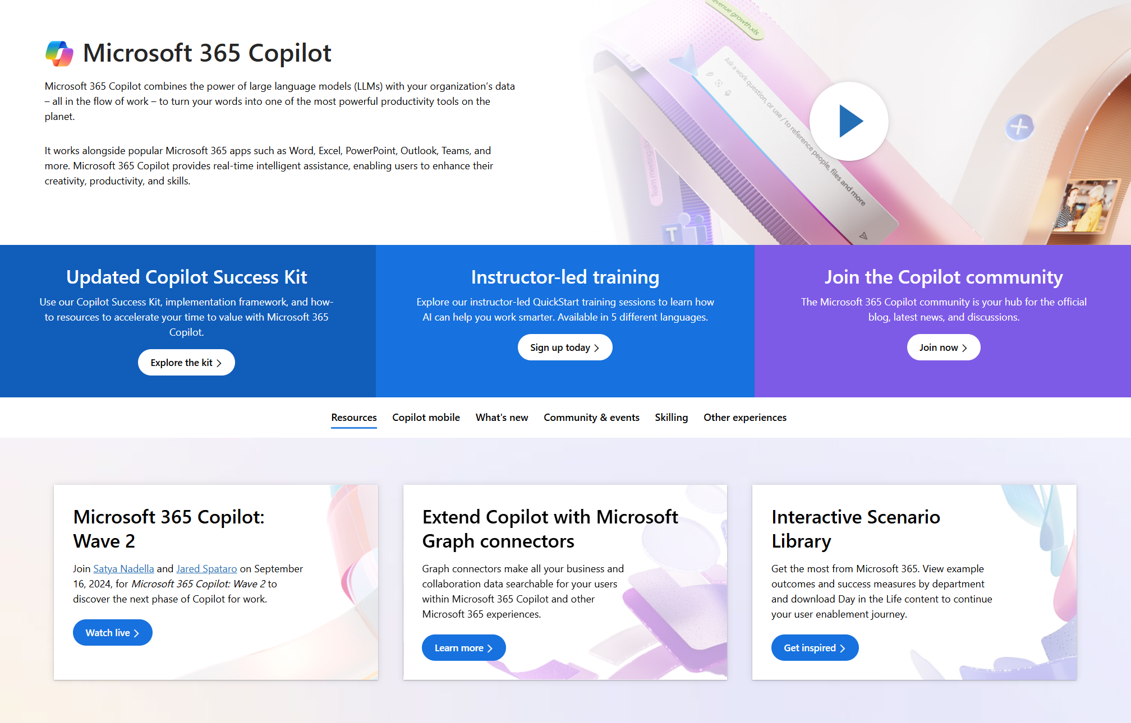
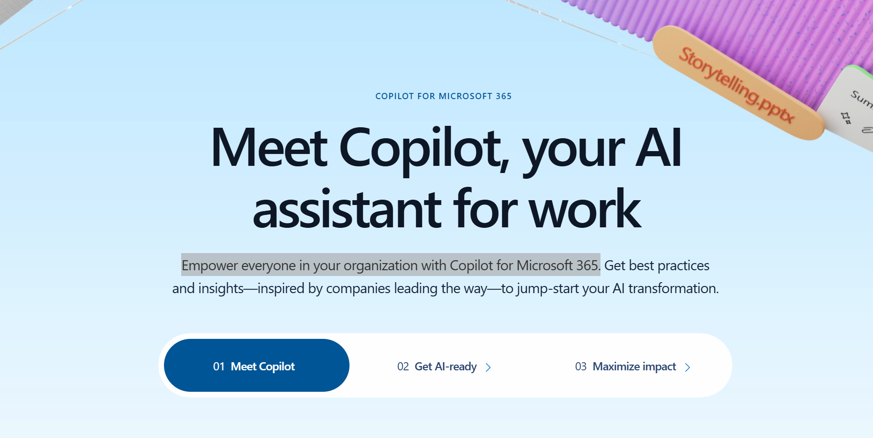
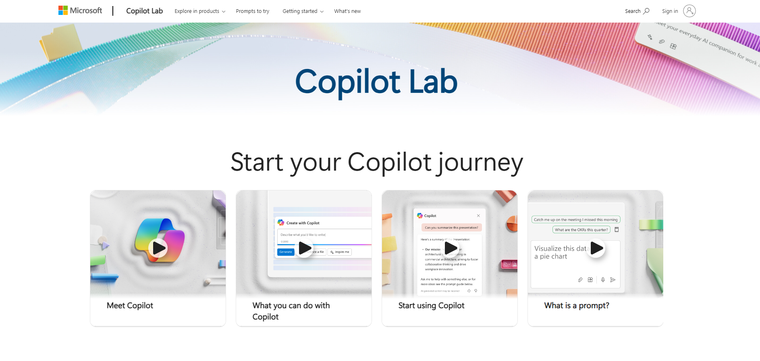
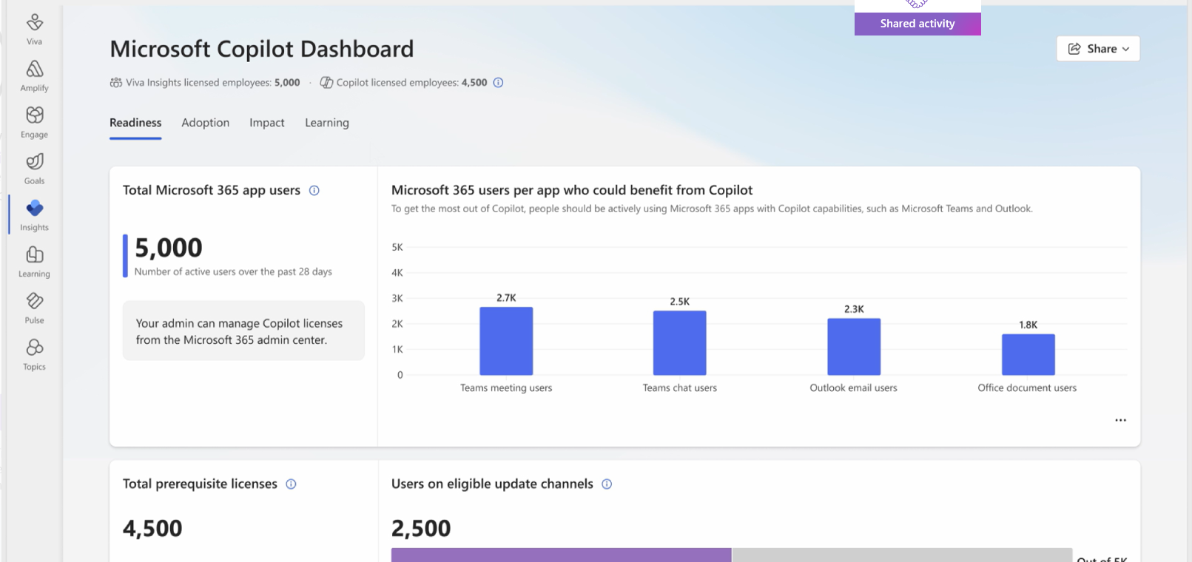
Essential Copilot implementation resources
Microsoft 365 Copilot Hub
Provides resources to help you drive the user enablement of Microsoft services:
Copilot Success Kit – a holistic guide that helps you think through the Leadership, Human change, and Technical readiness implementation journeys.
Copilot Scenario Library – provides business leaders inspiration on high-value scenarios to select, as well as KPIs they should measure for success.
Leading in the era of AI – Practical guidance for leaders of all types to get the most from the adoption of AI capabilities.
More resources
Meet Copilot
Empower everyone in your organization
with Microsoft 365 Copilot.
Copilot Prompt Gallery
Learn the art of prompting.
Copilot Dashboard
Business and IT leaders can plan their AI readiness,
drive adoption, and measure impact.

Slide 19
Thank you.

